Slide 1

Loan Analysis
Aishwarya, Bryce, Dani, Diamond
INFO 664

Slide 2

Who Are We?
We are a group of investors, looking for the target group of people to give out a personal loan with expectations that it will be fully paid off.

Slide 3
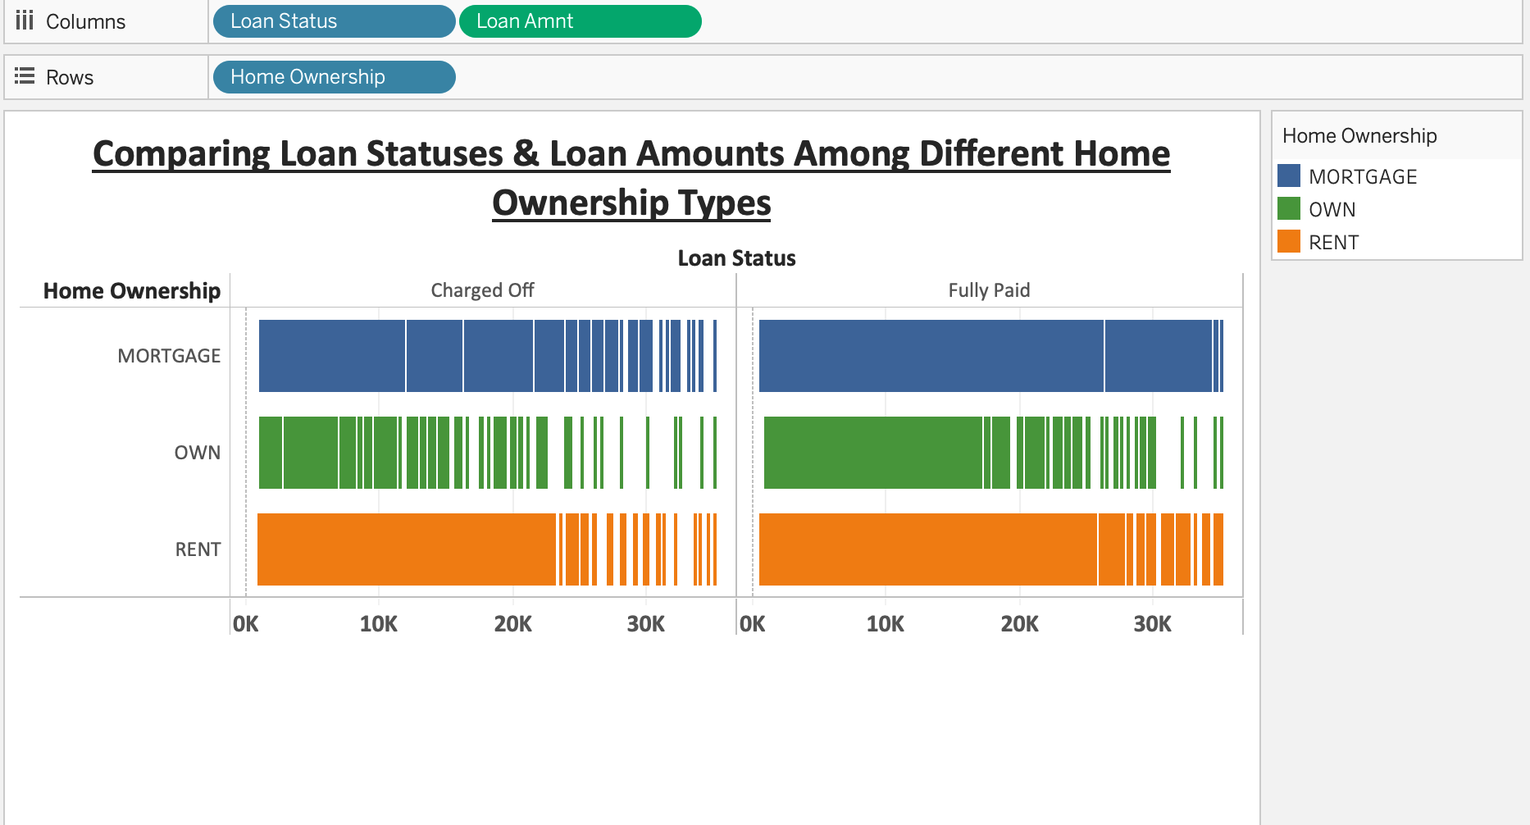
Visualization & Analysis

Slide 4
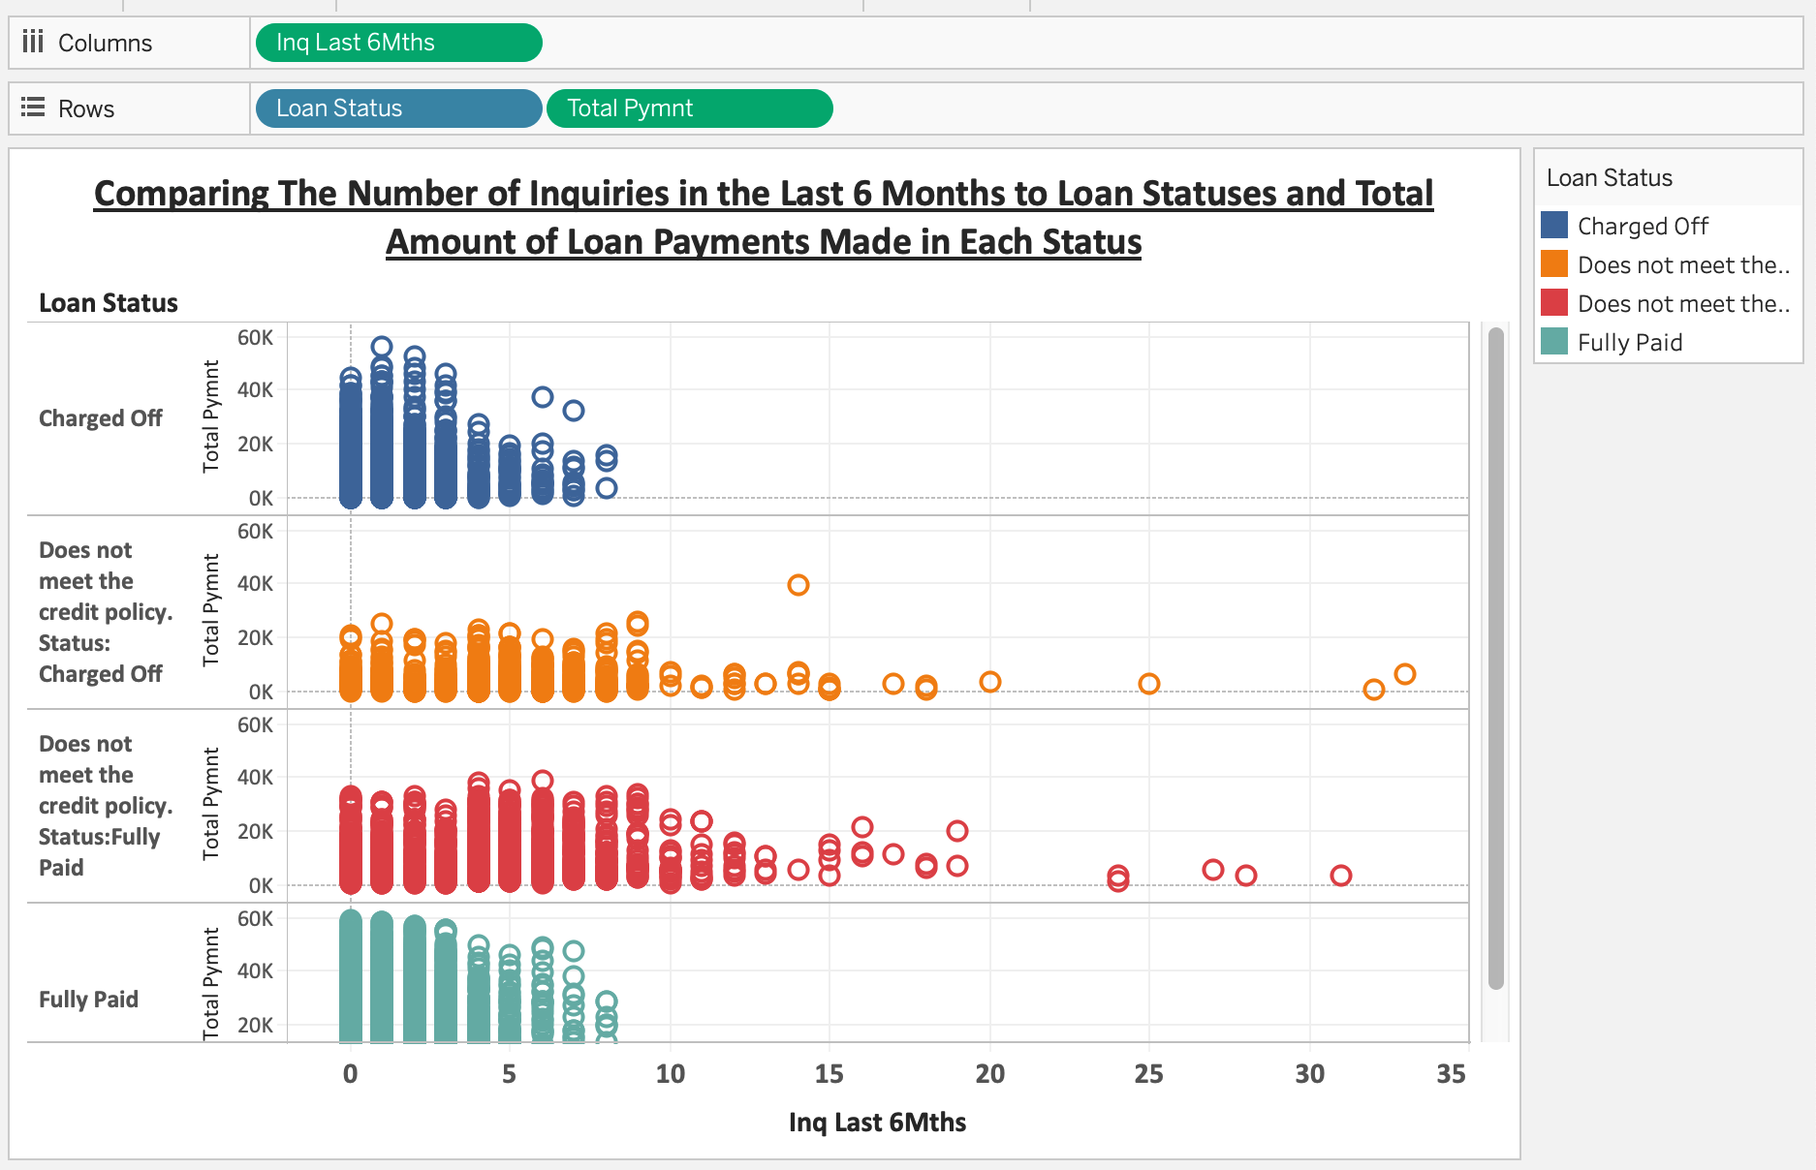
Visualization & Analysis

Slide 5
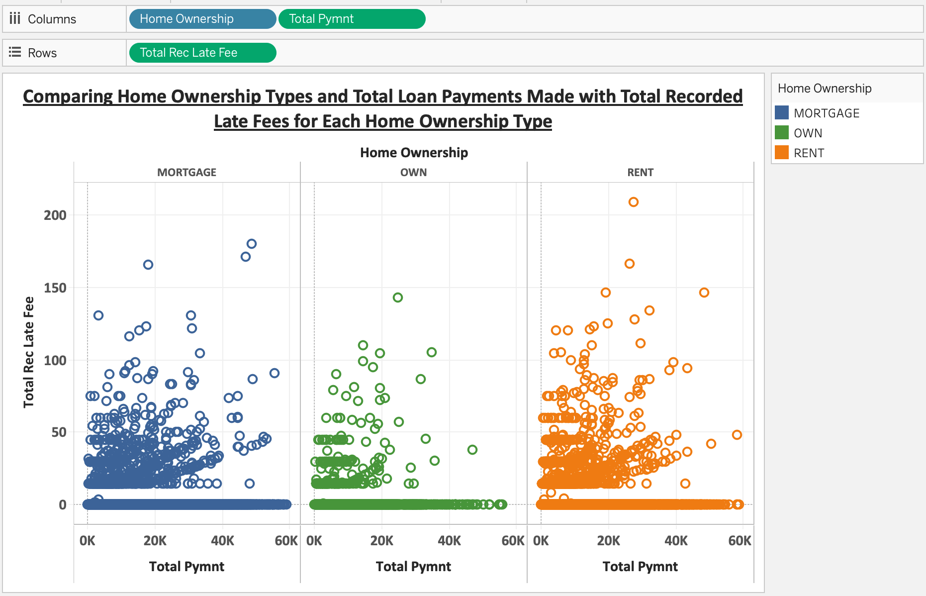
Visualization & Analysis

Slide 6
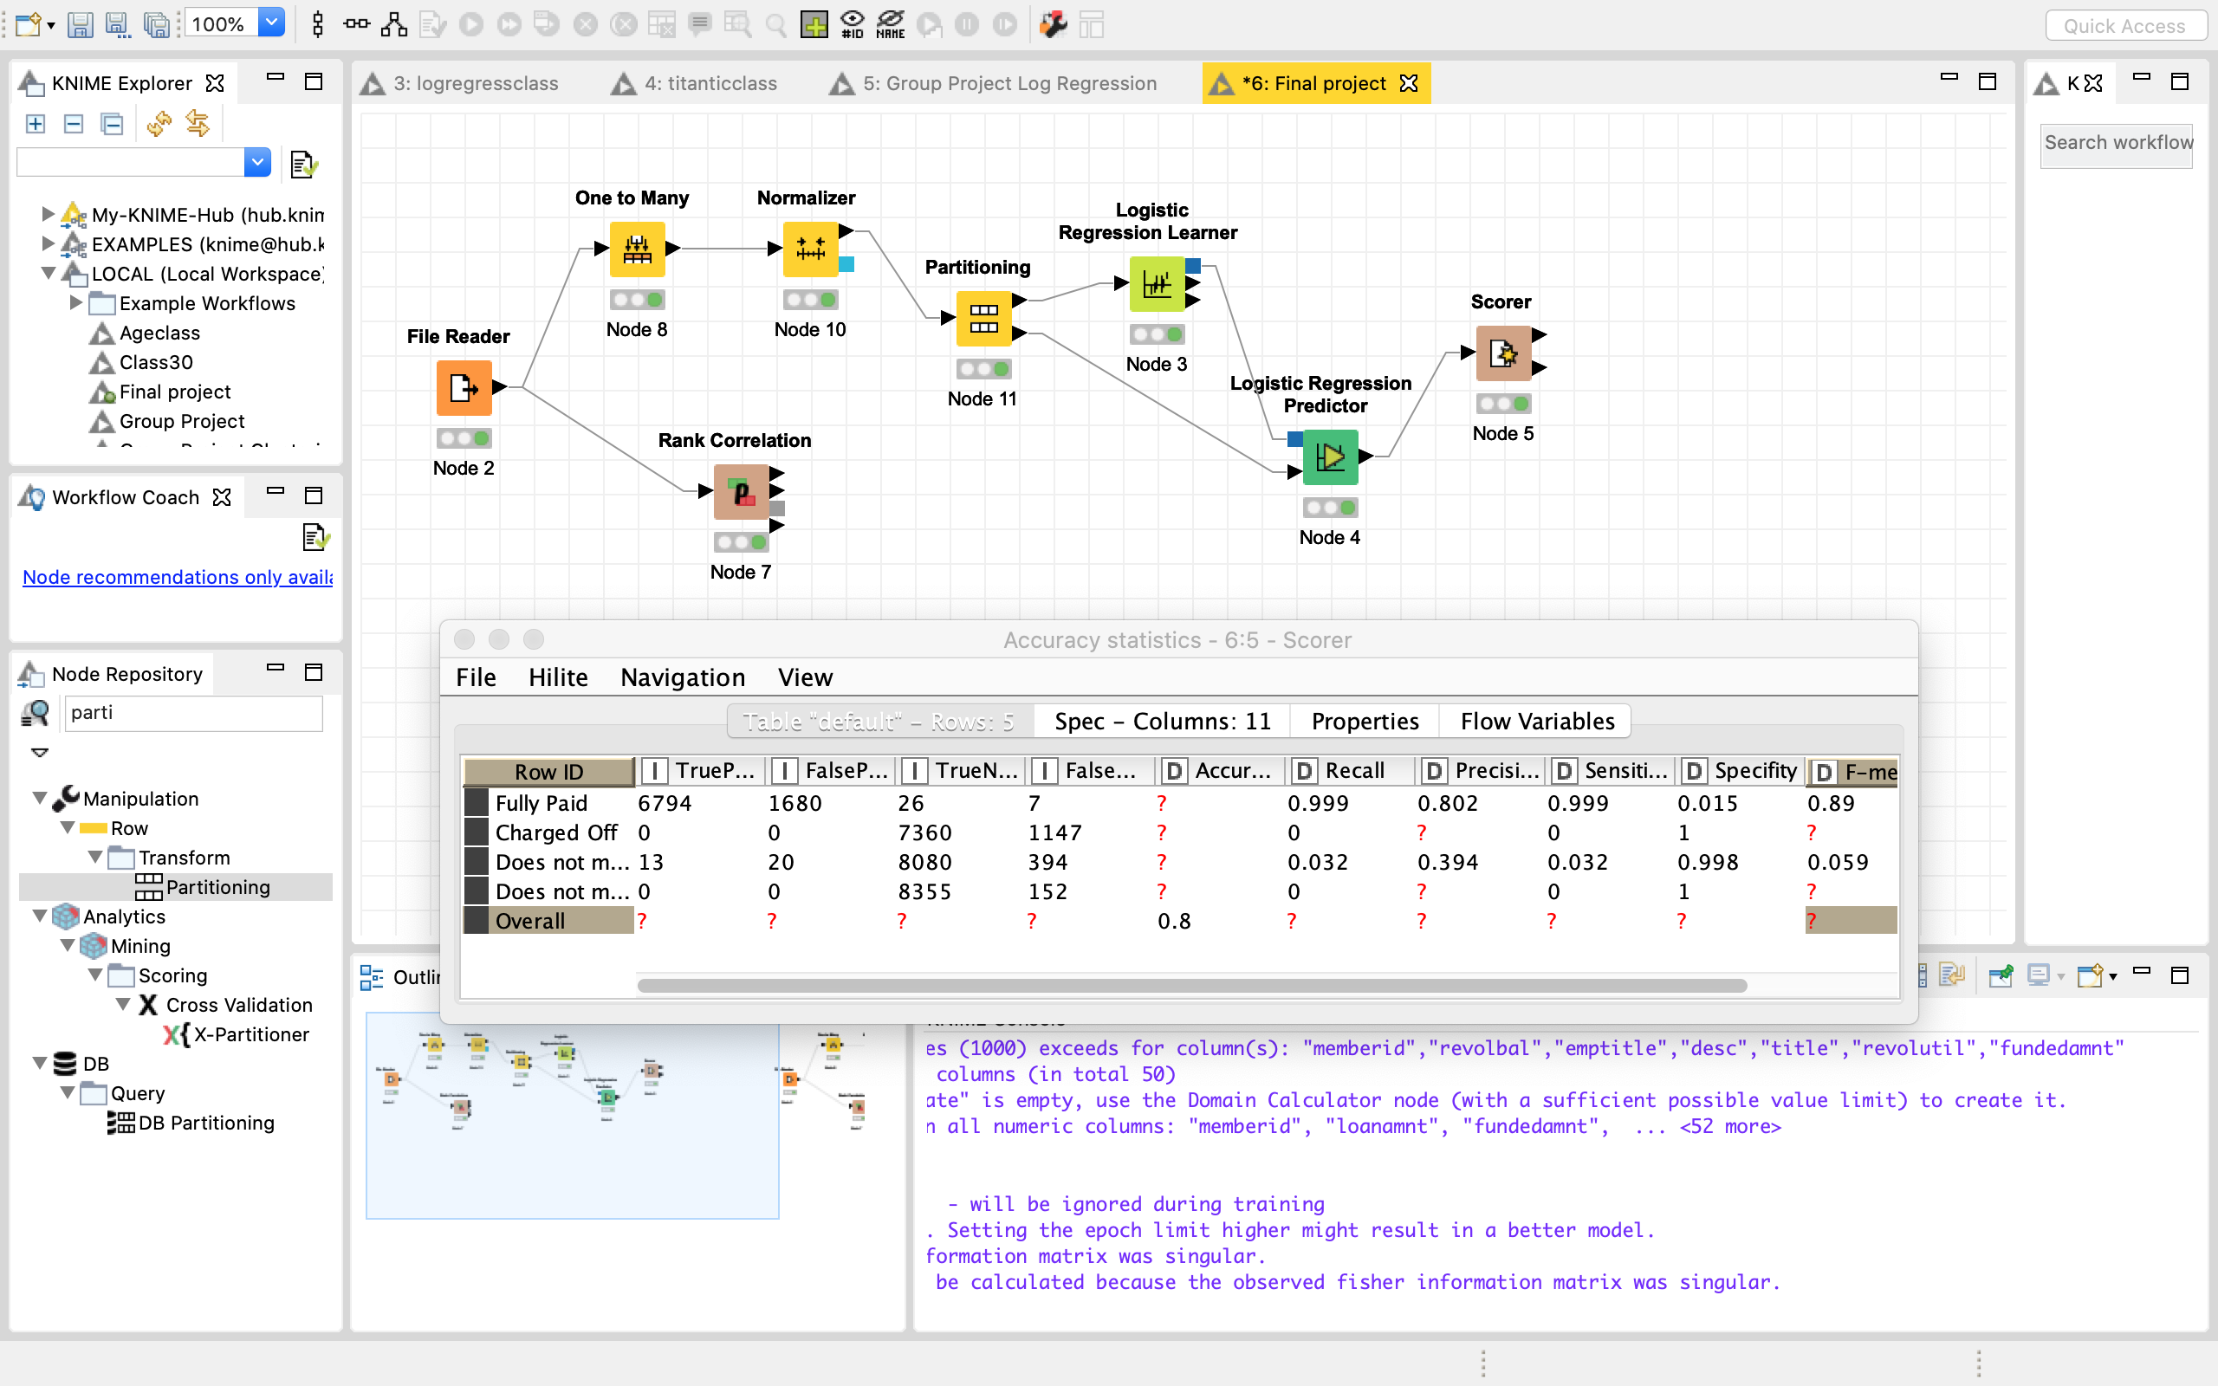
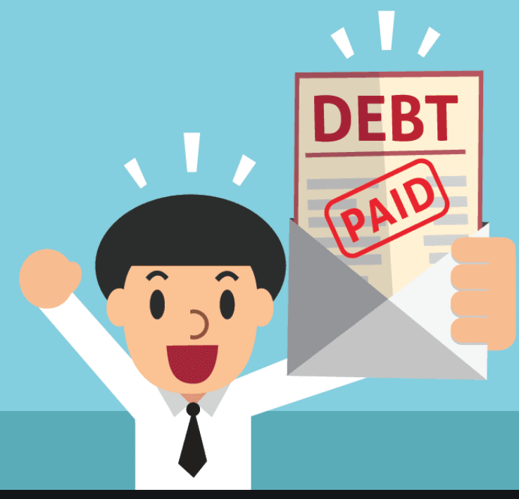
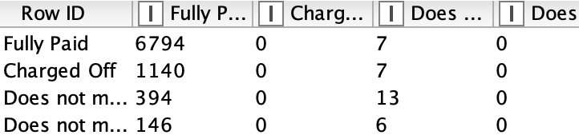
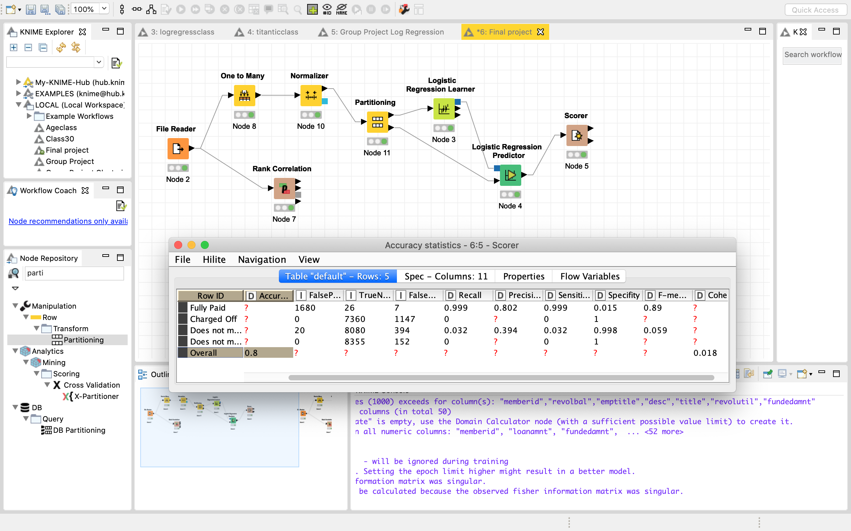
Logistic Regression
Model
Loan Status
Loan amount
Grade
Employee length
Homeownership
Payment Plan
Confusion Matrix
Accuracy Statistics

Slide 7
MS Excel: Data Table
Payment Per Month:
Data table created to reflect combinations of payment per month based on Interest Rate and Loan Amount
Can “Zero-in” on specific loan amounts and interest rates to choose which we prefer
The lower the interest rate, the better (less interest borrowers paid)
Trend in lower interest rates leads to higher loan grade
int_rate | term (months) | loan_amnt | PMT
11.68% | 41.80 | 11109.19 | -324.75 | =PMT(G48/12,H48,I48)
 |  | Loan Amount
PMT / Month | ($324.75) | 9000 | 10000 | 11000 | 12000 | 13000
Interest Rate | 6% | -239.13 | -265.70 | -292.27 | -318.84 | -345.41
 | 8% | -247.42 | -274.91 | -302.40 | -329.89 | -357.38
 | 10% | -255.87 | -284.30 | -312.73 | -341.16 | -369.59
 | 12% | -264.50 | -293.89 | -323.28 | -352.66 | -382.05
 | 14% | -273.29 | -303.66 | -334.02 | -364.39 | -394.76
 | 16% | -282.25 | -313.61 | -344.98 | -376.34 | -407.70
 | 18% | -291.38 | -323.76 | -356.13 | -388.51 | -420.88
 | 20% | -300.67 | -334.08 | -367.49 | -400.89 | -434.30
 | 22% | -310.12 | -344.58 | -379.04 | -413.50 | -447.96
 | 24% | -319.74 | -355.26 | -390.79 | -426.31 | -461.84
 | 26% | -329.51 | -366.12 | -402.73 | -439.34 | -475.95
int_rate | term (months) | loan_amnt | PMT
11.68% | 41.80 | 11109.19 | -324.75 | =PMT(G2/12,H2,I2)
 |  | Loan Amount
PMT / Month | ($324.75) | 1000 | 2000 | 3000 | 4000 | 5000 | 6000 | 7000 | 8000 | 9000 | 10000 | 11000 | 12000 | 13000 | 14000 | 15000 | 16000 | 17000 | 18000 | 19000 | 20000 | 21000 | 22000 | 23000 | 24000 | 25000 | 26000 | 27000 | 28000 | 29000 | 30000 | 31000 | 32000 | 33000 | 34000 | 35000
Interest Rate | 6% | -26.57 | -53.14 | -79.71 | -106.28 | -132.85 | -159.42 | -185.99 | -212.56 | -239.13 | -265.70 | -292.27 | -318.84 | -345.41 | -371.98 | -398.55 | -425.12 | -451.694 | -478.264 | -504.834 | -531.404 | -557.974 | -584.545 | -611.115 | -637.685 | -664.255 | -690.826 | -717.396 | -743.966 | -770.536 | -797.106 | -823.677 | -850.247 | -876.817 | -903.387 | -929.957
 | 8% | -27.49 | -54.98 | -82.47 | -109.96 | -137.45 | -164.94 | -192.44 | -219.93 | -247.42 | -274.91 | -302.40 | -329.89 | -357.38 | -384.87 | -412.36 | -439.85 | -467.343 | -494.833 | -522.324 | -549.815 | -577.306 | -604.796 | -632.287 | -659.778 | -687.269 | -714.759 | -742.25 | -769.741 | -797.232 | -824.722 | -852.213 | -879.704 | -907.194 | -934.685 | -962.176
 | 10% | -28.43 | -56.86 | -85.29 | -113.72 | -142.15 | -170.58 | -199.01 | -227.44 | -255.87 | -284.30 | -312.73 | -341.16 | -369.59 | -398.02 | -426.45 | -454.88 | -483.315 | -511.745 | -540.175 | -568.605 | -597.036 | -625.466 | -653.896 | -682.327 | -710.757 | -739.187 | -767.617 | -796.048 | -824.478 | -852.908 | -881.338 | -909.769 | -938.199 | -966.629 | -995.06
 | 12% | -29.39 | -58.78 | -88.17 | -117.55 | -146.94 | -176.33 | -205.72 | -235.11 | -264.50 | -293.89 | -323.28 | -352.66 | -382.05 | -411.44 | -440.83 | -470.22 | -499.607 | -528.996 | -558.385 | -587.774 | -617.162 | -646.551 | -675.94 | -705.328 | -734.717 | -764.106 | -793.494 | -822.883 | -852.272 | -881.66 | -911.049 | -940.438 | -969.826 | -999.215 | -1028.6
 | 14% | -30.37 | -60.73 | -91.10 | -121.46 | -151.83 | -182.19 | -212.56 | -242.93 | -273.29 | -303.66 | -334.02 | -364.39 | -394.76 | -425.12 | -455.49 | -485.85 | -516.219 | -546.584 | -576.95 | -607.316 | -637.682 | -668.048 | -698.413 | -728.779 | -759.145 | -789.511 | -819.877 | -850.243 | -880.608 | -910.974 | -941.34 | -971.706 | -1002.07 | -1032.44 | -1062.8
 | 16% | -31.36 | -62.72 | -94.08 | -125.45 | -156.81 | -188.17 | -219.53 | -250.89 | -282.25 | -313.61 | -344.98 | -376.34 | -407.70 | -439.06 | -470.42 | -501.78 | -533.145 | -564.507 | -595.868 | -627.23 | -658.591 | -689.953 | -721.314 | -752.676 | -784.037 | -815.399 | -846.76 | -878.122 | -909.483 | -940.845 | -972.206 | -1003.57 | -1034.93 | -1066.29 | -1097.65
 | 18% | -32.38 | -64.75 | -97.13 | -129.50 | -161.88 | -194.25 | -226.63 | -259.00 | -291.38 | -323.76 | -356.13 | -388.51 | -420.88 | -453.26 | -485.63 | -518.01 | -550.385 | -582.76 | -615.136 | -647.512 | -679.887 | -712.263 | -744.638 | -777.014 | -809.389 | -841.765 | -874.141 | -906.516 | -938.892 | -971.267 | -1003.64 | -1036.02 | -1068.39 | -1100.77 | -1133.15
 | 20% | -33.41 | -66.82 | -100.22 | -133.63 | -167.04 | -200.45 | -233.86 | -267.26 | -300.67 | -334.08 | -367.49 | -400.89 | -434.30 | -467.71 | -501.12 | -534.53 | -567.934 | -601.341 | -634.749 | -668.157 | -701.565 | -734.973 | -768.381 | -801.789 | -835.196 | -868.604 | -902.012 | -935.42 | -968.828 | -1002.24 | -1035.64 | -1069.05 | -1102.46 | -1135.87 | -1169.28
 | 22% | -34.46 | -68.92 | -103.37 | -137.83 | -172.29 | -206.75 | -241.21 | -275.67 | -310.12 | -344.58 | -379.04 | -413.50 | -447.96 | -482.41 | -516.87 | -551.33 | -585.788 | -620.246 | -654.704 | -689.163 | -723.621 | -758.079 | -792.537 | -826.995 | -861.453 | -895.911 | -930.369 | -964.828 | -999.286 | -1033.74 | -1068.2 | -1102.66 | -1137.12 | -1171.58 | -1206.03
 | 24% | -35.53 | -71.05 | -106.58 | -142.10 | -177.63 | -213.16 | -248.68 | -284.21 | -319.74 | -355.26 | -390.79 | -426.31 | -461.84 | -497.37 | -532.89 | -568.42 | -603.945 | -639.471 | -674.997 | -710.523 | -746.05 | -781.576 | -817.102 | -852.628 | -888.154 | -923.68 | -959.207 | -994.733 | -1030.26 | -1065.79 | -1101.31 | -1136.84 | -1172.36 | -1207.89 | -1243.42
 | 26% | -36.61 | -73.22 | -109.84 | -146.45 | -183.06 | -219.67 | -256.28 | -292.89 | -329.51 | -366.12 | -402.73 | -439.34 | -475.95 | -512.56 | -549.18 | -585.79 | -622.4 | -659.011 | -695.623 | -732.235 | -768.847 | -805.458 | -842.07 | -878.682 | -915.294 | -951.905 | -988.517 | -1025.13 | -1061.74 | -1098.35 | -1134.96 | -1171.58 | -1208.19 | -1244.8 | -1281.41
Notes:
Had to do a little data manipulation to get the term in correct form to be able to work with
can show how different combinations of interest rates and loan amounts will affect a monthly payment.
All is filtered to fully paid off and zero “total_rec_late_fee” so we know they are reliable loans
Can “Zero-in” on specific loan amounts and interest rates to choose which we prefer
We see a trend in the lower the interest rate is, the higher the grade is
The averages in the above example tell me that the majority of people that paid their loans off had a
relatively shorter loan term
lower interest rate
lower loan amount
and lower overall payment per term

Slide 8
Conclusion
Our target group should be individuals who fully pay their loans since their the safest investment.
We should then focus on certain factors within that target group specifically:
With less inquiries within 6 months
Homeownership status- mortgage
Loan amount
Interest rate
Grade- higher the better
Employee length- longer the better

